Slide 1
STUDENT, STAFF AND VISITOR DISABILITY SUPPORT
THE WAY WE DO THINGS AT PARK LANE ACADEMY
KEY GUIDANCE AND INFORMATION FOR ALL STAKEHOLDERS
PRIDE :: RESPECT :: AMBITION

Slide 2
Park Lane Academy’s Vision
Our academy aims to treat all its students fairly and with respect. This involves providing access and opportunities for all students without discrimination.
To meet this aim we ensure the academy’s physical environment is suitable and accessible for pupils and to ensure they can access their learning and wider academy activities without barriers.
Our academy was built with accessibility in mind and we have a range of adaptations to the fabric of the building to support disabled pupils.

Slide 3
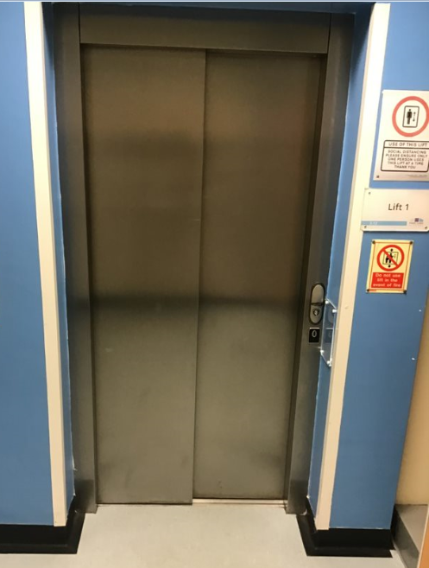
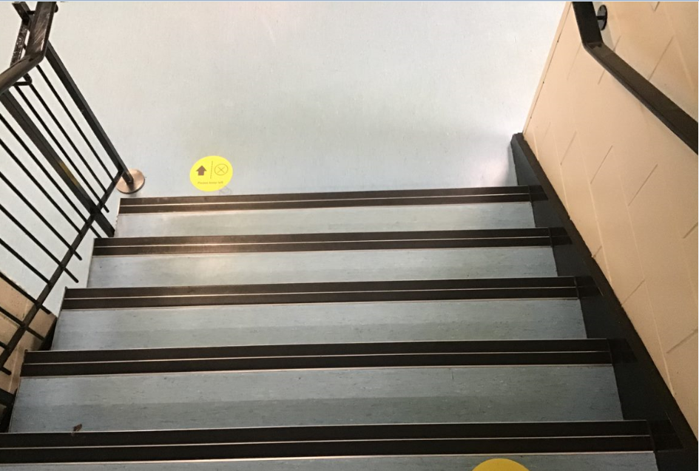
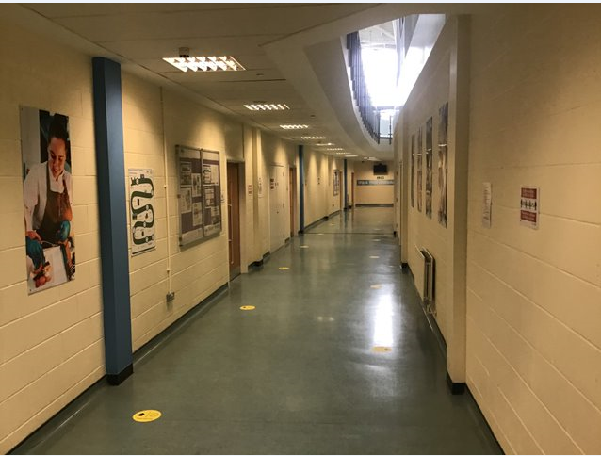
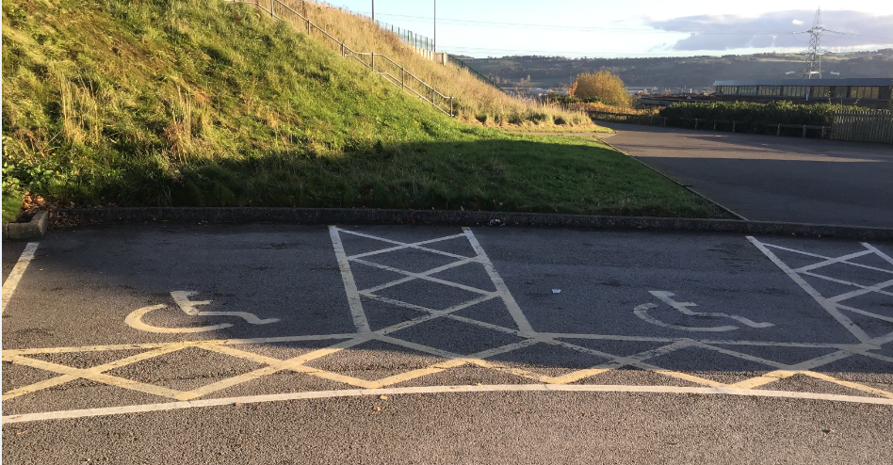
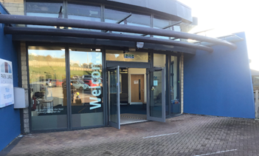
Our Adaptations
To support all those who attend, visit or work in our academy we have a range of features to support their movement in and around the academy
Lifts that allow access to all floors for those with mobility needs
Colour contrasted stairs/edging for those with visual impairments
Wide corridors for access for wheelchair users or those with other mobility issues or needs
Designated disabled parking bays near reception and a flat easy access through our principal door

Slide 4
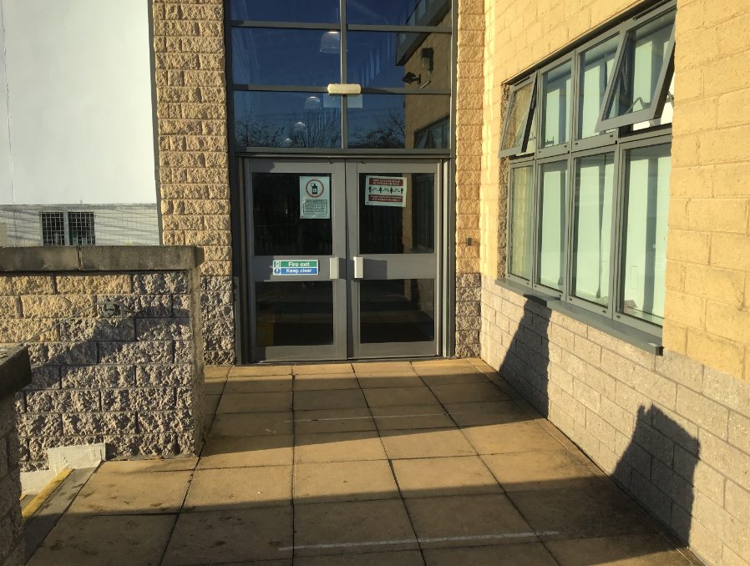
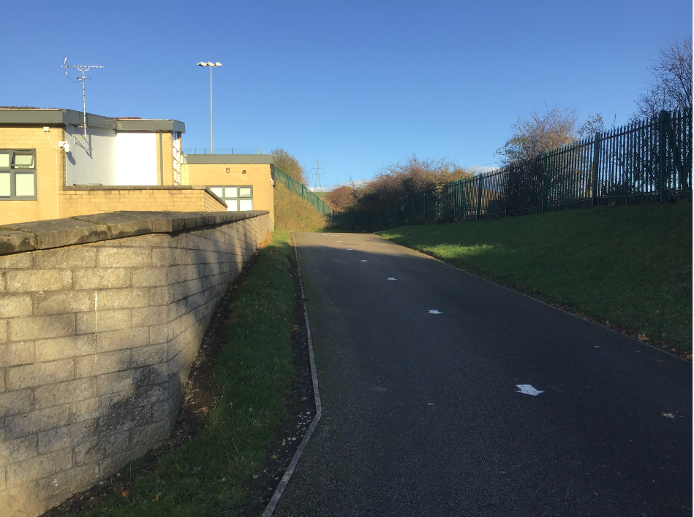
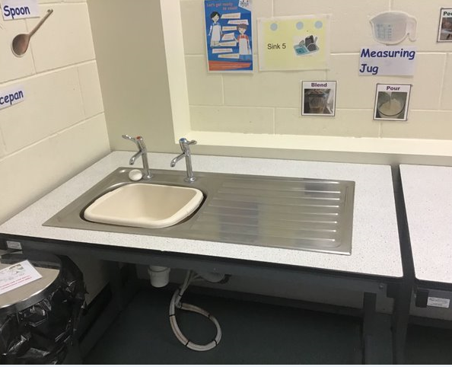
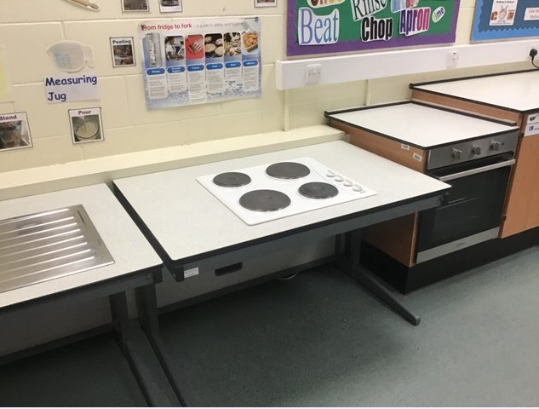
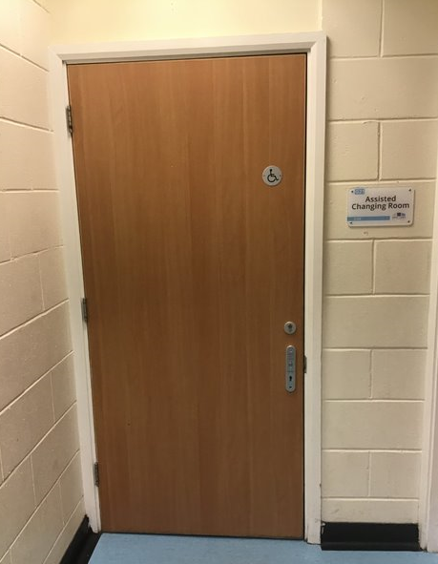
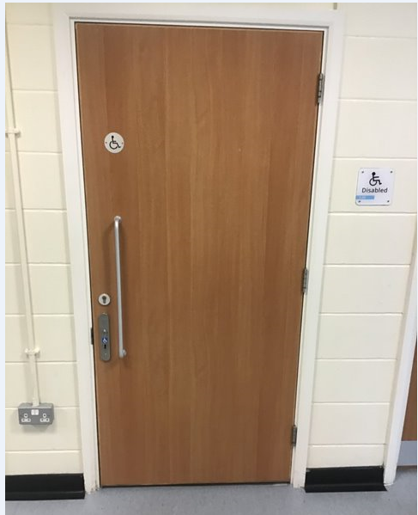
Wide doors that don’t require assistance to use
Slope for alternative access/egress from the school
Adapted, lower work stations for disable pupils
Specific changing and toilet facilities for those with disability needs

Slide 5
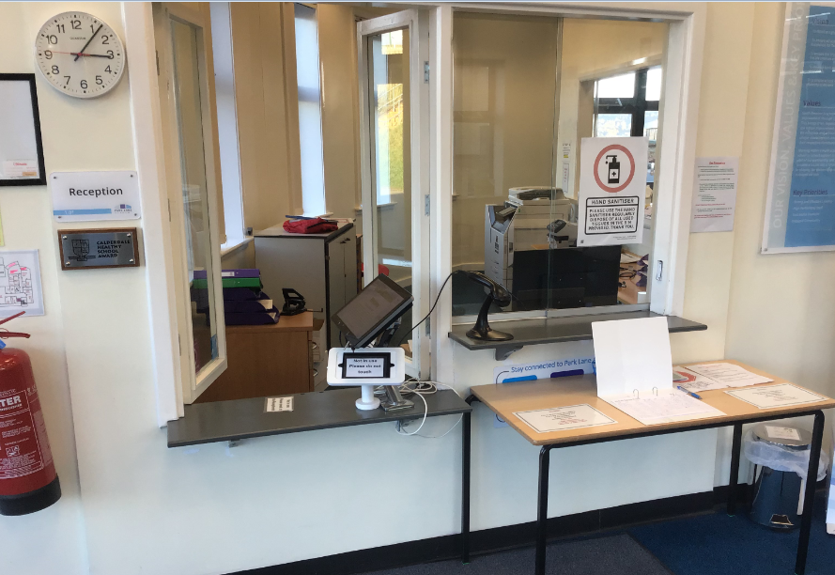
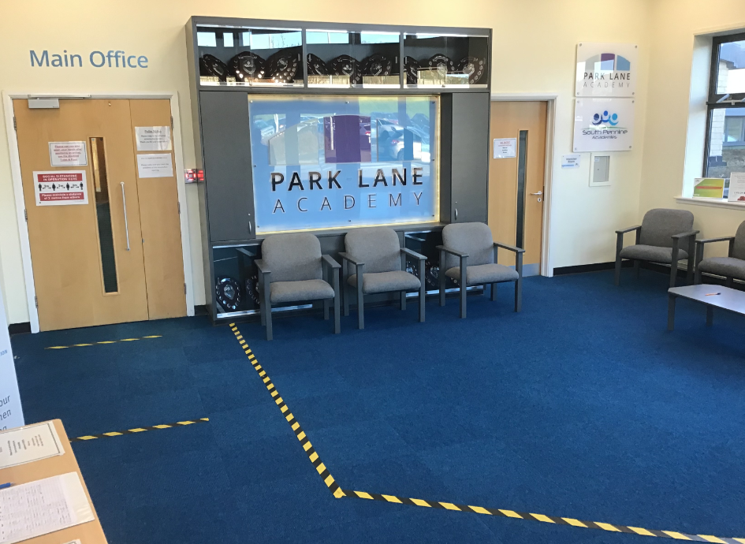
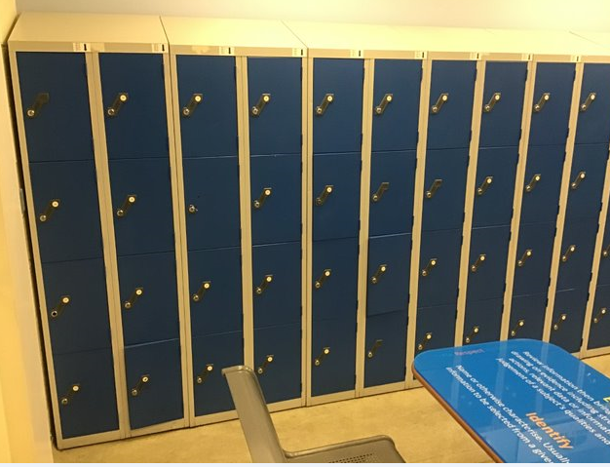
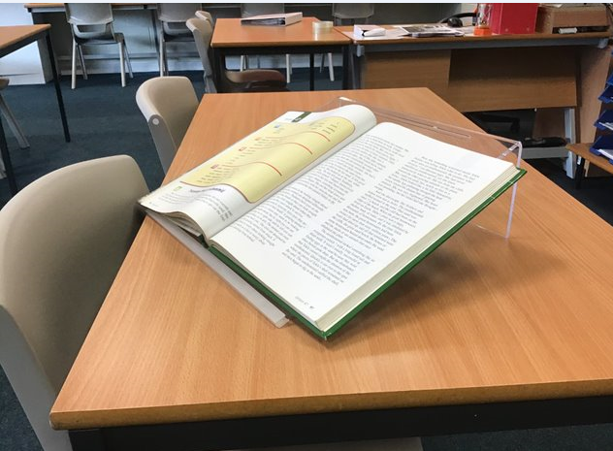
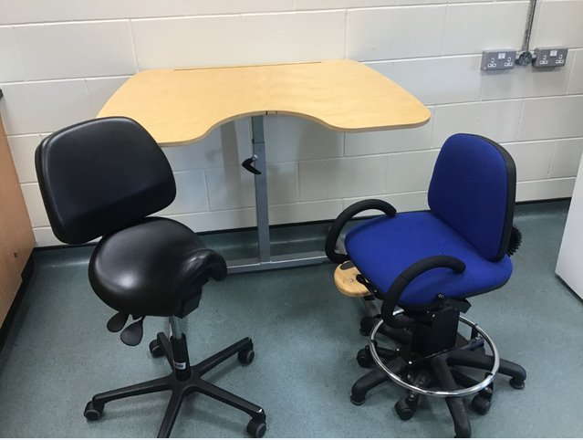
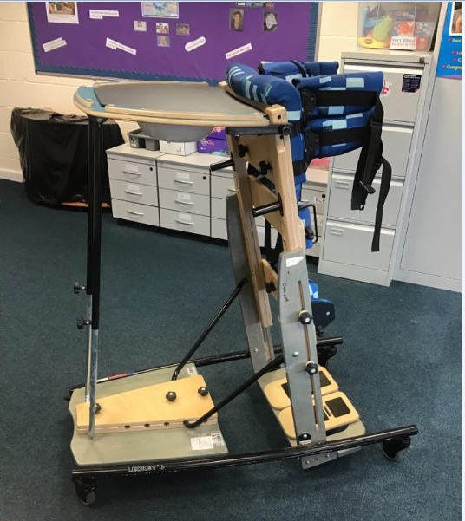
Lower counter with hearing loop support
Wide space to manoeuvre around reception
Lockers to support students with bags with a ranging height for accessibility
A range of adaptive furniture and work platforms for pupils to access activities comfortably and physiotherapeutic devices as directed by the NHS

